Slide 1

Augmented Reality
Prepared By: Sachin Verma Roll Number : 038
CSE 2k18
01

Slide 2

CONTENTS
What is Augmented Reality?
Augmented Reality vs Virtual Reality
Milgram's Reality-virtuality continuum
Combining the Real and Virtual Reality
How does AR works?
What is needed in AR?

Slide 3

CONTENTS
Display Technologies - a) Monitor Based
b) Head Mounted Display
Monitor Based AR
Optical See through HMD
Video See through HMD
Future of AR

Slide 4


Augmented Reality is a field of computer research
which deals with combination of reality with computer generated data.
It is still in an early stage of research and development, possibly by the end of this decade, we will see the first mass-marketed augmented-reality system.
What is AR
04

Slide 5
Augmented Reality vs. Virtual Reality
1
System augments the real world scene.
1
Totally immersive environment
2
User maintains a sense of presence in real world.
2
Senses are under control of system.
Needs a mechanism to combine virtual and real worlds, hard to register real and virtual
Need a mechanism to feed virtual world to user and it is hard to make VR world interesting.
3
3
05

Slide 6
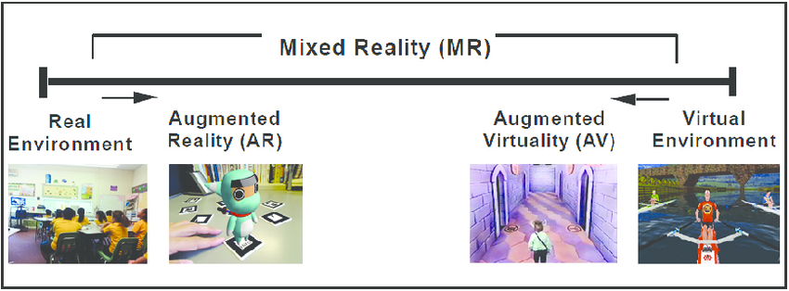
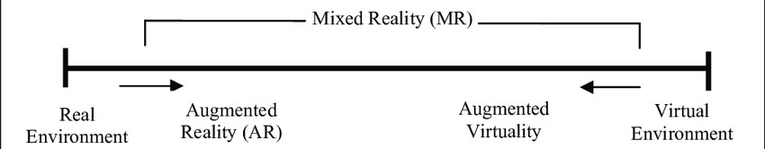
Milgram's Reality-Vituality Continuum
The concept Reality–virtuality continuum was first introduced by Paul Milgram. The reality–virtuality continuum is variations and compositions of real and virtual objects.The virtuality continuum is a continuous scale ranging between the completely virtual, a virtuality, and the completely real, reality.
06

Slide 7
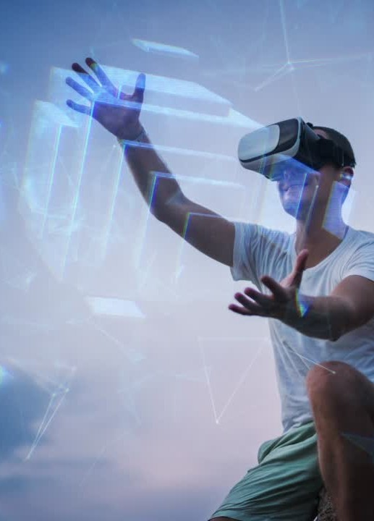
COMBINING THE
REAL AND VITUAL
WORLD
a) Precise Models
We need :
Locations and optical properties of the viewer( or
Camera) and the display
Calibration of all devices
d) To combine all local coordinate systems centered on the devices and the objects in the scene in a global coordinate system.
07

Slide 8


HOW DOES AR WORK?
The basic idea of augmented reality is to superimpose graphics, audio and other senses enhancements over a real-world environment in real-time.
The graphics will then change to accommodate the user's eye or head movements.

Slide 9


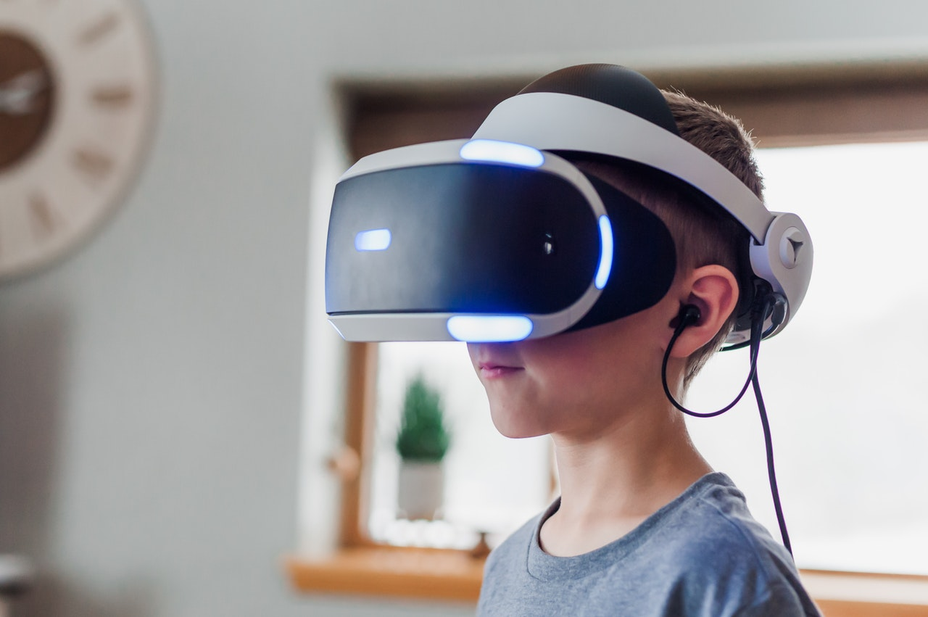
WHAT IS NEEDED?
09
Head-mounted display
Tracking System
Mobile computing power

Slide 10
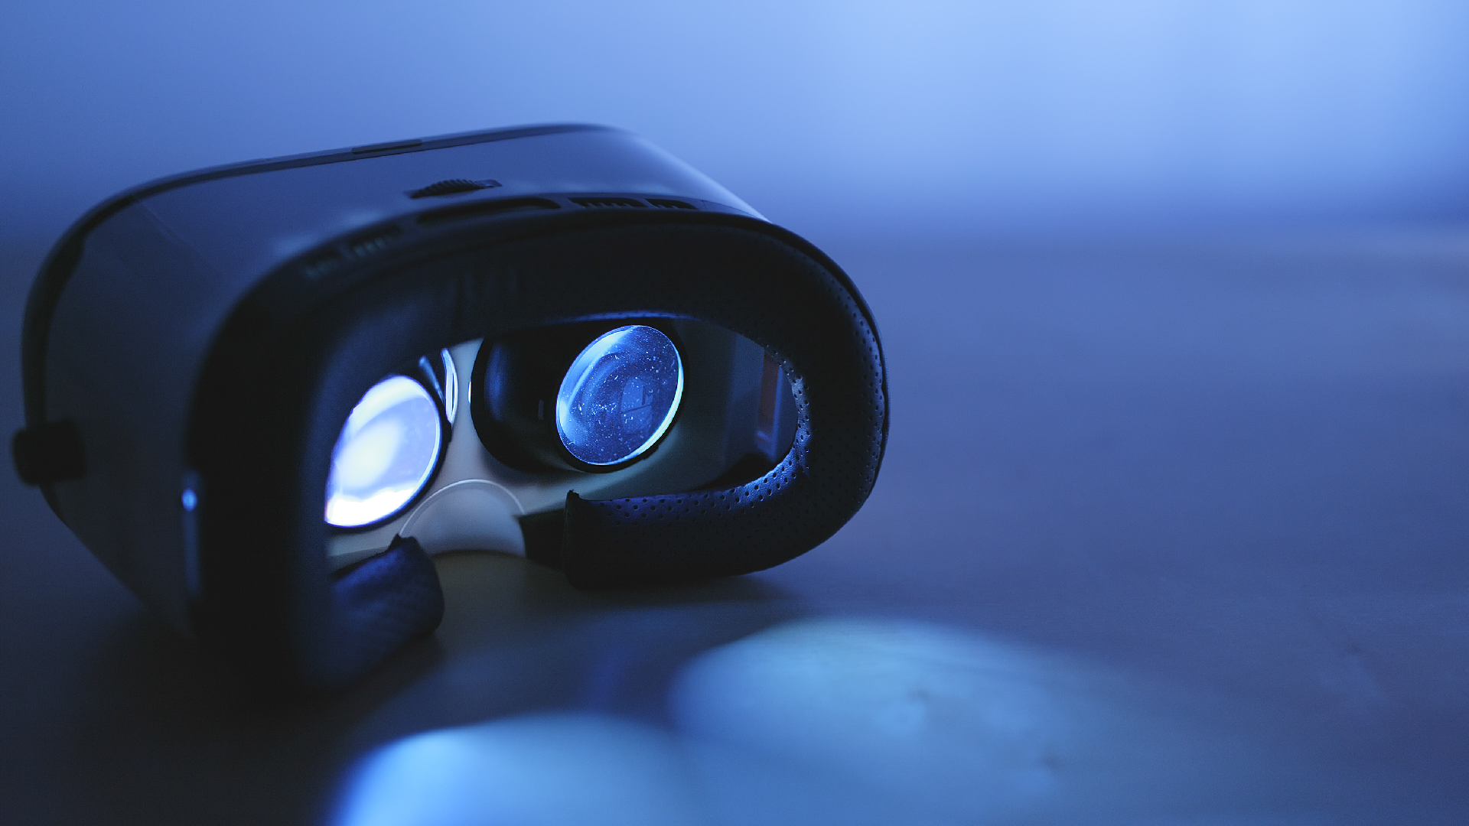
Display Technologies
MONITOR BASED DISPLAYS
HEAD MOUNTED DISPLAYS
Laptops
-Video See-through
-Cell Phones
-Optical See-through
-Projectors

Slide 11
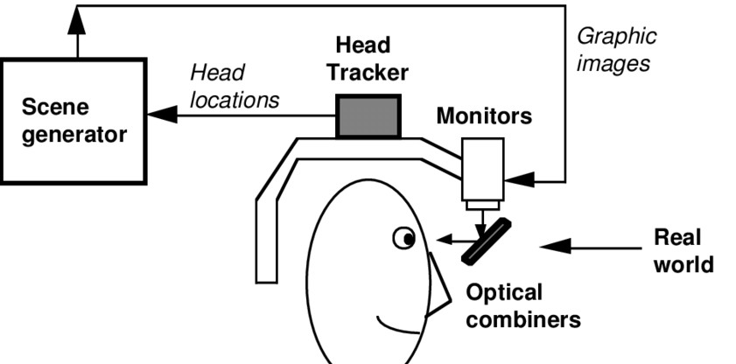
OPTICAL SEE-THROUGH HMD
11

Slide 12
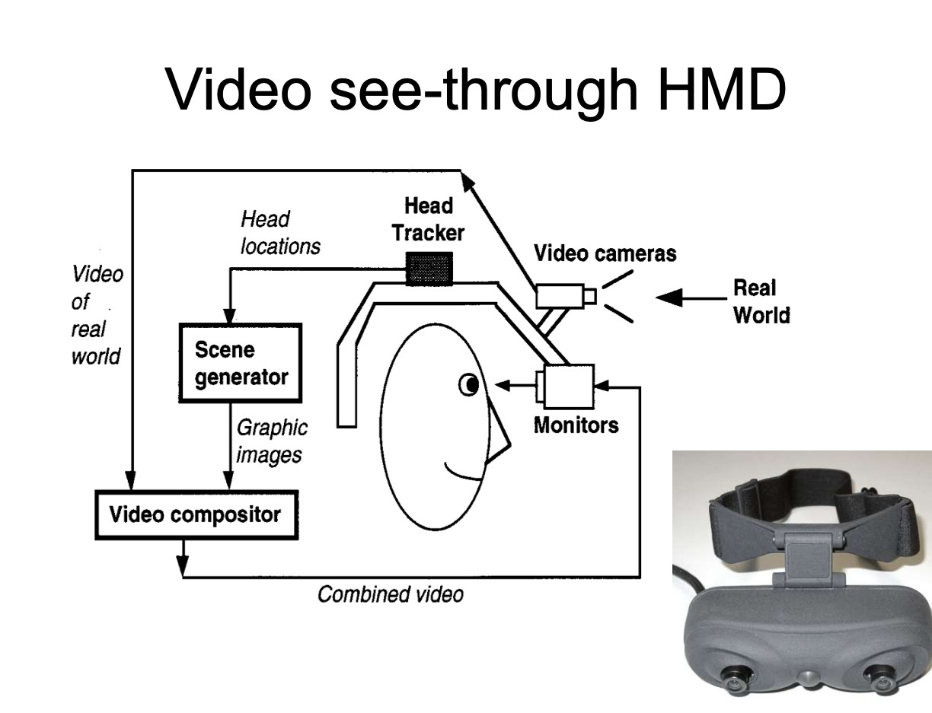
VIDEO SEE-THROUGH HMD
12

Slide 13
ADVANTAGES OF
VIDEO SEE THROUGH HMD
FLEXIBILITY IN COMPOSITION STRATEGIES.
REAL AND VIRTUAL VIEWS DELAYS CAN BE MATCHED.

Slide 14
ADVANTAGES OF
OPTCAL SEE THROUGH HMD
SIMPLICITY
RESOLUTION
NO EYE OFFSET

Slide 15
MILITARY
AR system could provide troops with vital informations about their surroundings.
MEDICAL
Superimpose an image from an MRI onto a patient's body. This might allow surgeons to pinpoint a tumor to remove.
EDUCATION
Used in lans where students can learn more
about the experiments they are participating in.
GAMING
ARQuake is an AR version of the popular game Quake.
TRAVEL AND TOURISM
AR services offer Hotels and accommodations to engage interactively with guests and
travelers.
FUTURE OF
AUGMENTED REALITY

